Slide 1
Mindfulness R0om
Hamilton High School
Social Work Team

Slide 2
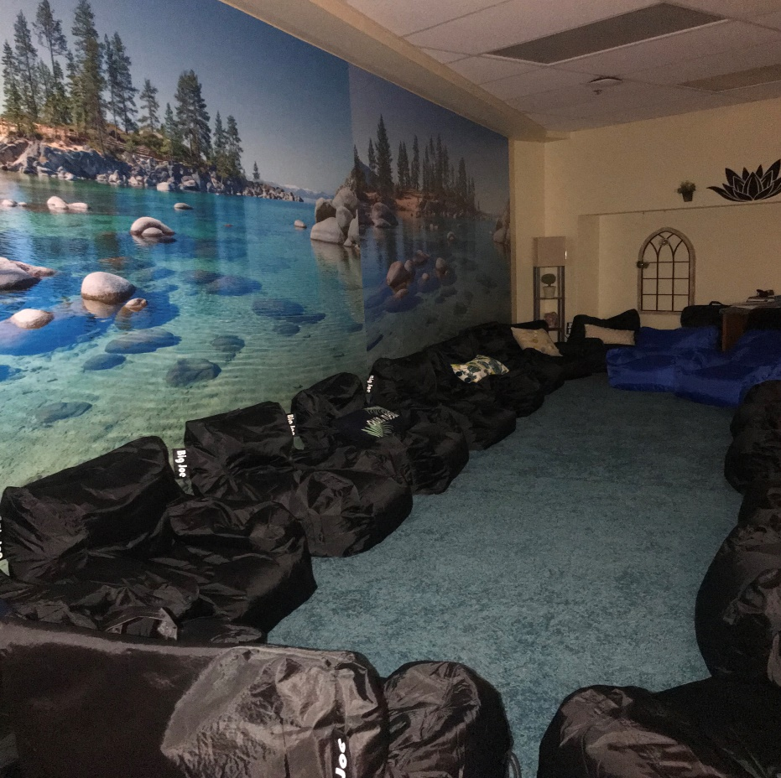
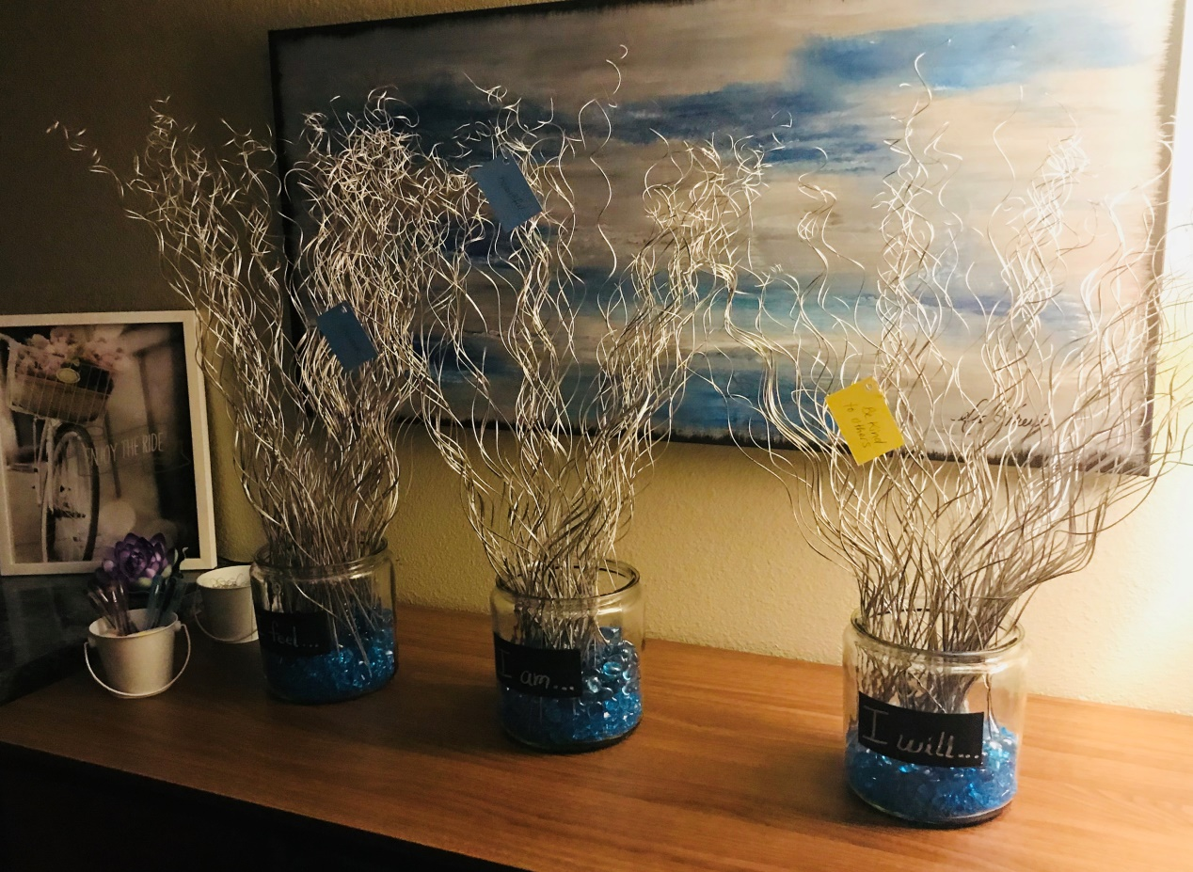
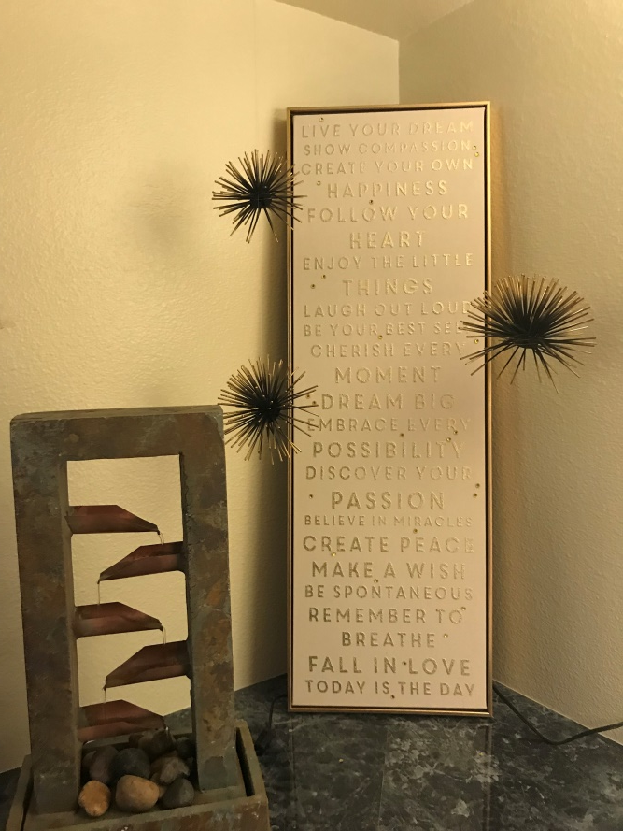
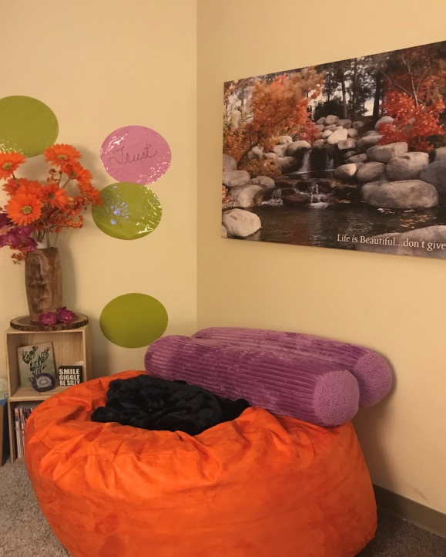
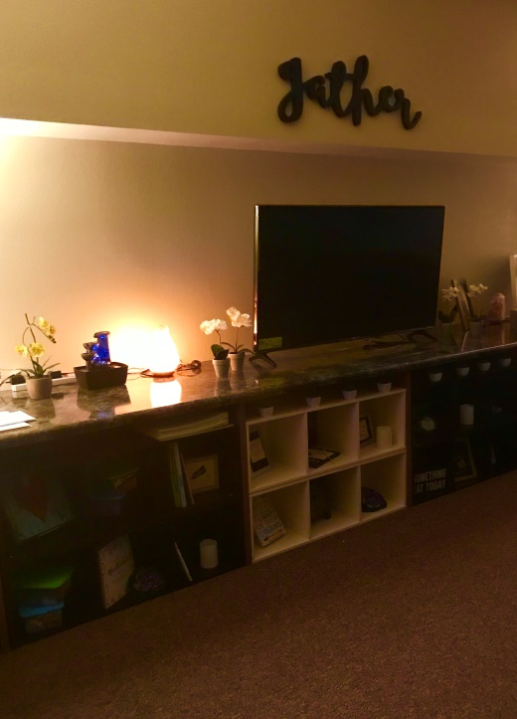
Mindfulness Center

Slide 3
What is Mindfulness?
Mindfulness involves being aware of our thoughts, emotions, and being present with oneself and our surroundings.
It means being in the moment and paying attention to what is happening in the ‘here and now’ with openness and curiosity, instead of focusing on our past memories or future worries.
Mindfulness involves acceptance of our feelings in a non-judgmental way.

Slide 4
Common Teen Issues
Responsibilities related to school, college applications, and extracurricular activities
Expectations from parents, teachers, coaches, and peers.
Emotional break-ups, conflicts with friends, social media
and other stressful social situations
Mental health conditions such as: depression, anxiety, and other mood disorders

Slide 5
Benefits of Mindfulness
Increase focus/concentration in school and other activities
Improve mental health and wellbeing
Develop insight and self awareness
Build healthier relationships (improve communication skills)
Help regulate emotions (reduce impulsive behaviors)
Increase feelings of empathy (imagining others experiences)
Create HAPPINESS!!

Slide 6
Mindfulness Center Details
Who: Open to all Hamilton Students!
Up-to 20 students can attend during each lunch period once a week.
What: Learn and practice Mindfulness skills, Meditation, Yoga, and other relaxation and breathing techniques.
When: (Mon., Tues., Fri.) (Wed., and Thurs.)
A Lunch: 10:44 – 11:04am A Lunch: 10:01 – 10:21am
B Lunch: 11:19 – 11:39am B Lunch: 10:57 – 11:17am
C Lunch: 11:52 – 12:12pm C Lunch: 11:58 – 12:18pm
Where: Room E223
Facilitators: Social Workers, Mrs. Rastogi, Ms. Julianne, ASU SW Intern, Jamie Novotny and professional speakers every Friday.
Sign up sheets will be available outside Room E223 every morning

Slide 7
Meditation & The Brain
https://www.youtube.com/watch?v=Bu04GE8lzCE

Slide 8
Mindfulness and the Brain

Slide 9
Incorporating a Mindful Minute in your classroom
What would happen if we spent the first one minute in class not explaining, reading, taking notes, or discussing?
What if we just sat there—in silence?
What if we stepped out of our “thinking minds” before engaging in the usual thinking that goes on in class?
What if we started by letting awareness take center stage?
Research: greater stress reduction, more emotional stability, focus in class, greater ability to respond to situations with more awareness instead of impulsivity.

Slide 10
Classroom Mindful Minute

Slide 11
Please contact your Hamilton Social Workers if you need any additional support or if you would like to bring your classroom for a 20 minute Mindfulness Presentation in E223 (Mindfulness Room).
Rajani Rastogi, LMSW – x5182
Julianne Haddad, LMSW – x5275

